Slide 1
Methods for improving and characterizing gene families
AKSHAY YADAV
Notes:
Here we will look at some methods for correcting and characterizing gene families built using any existing methods.
These methods were mainly built to be applied on legume genomes but can be applied on any families from any set of species

Slide 2
Gene family - definition
Group of genes that have descended from a common ancestral gene present in the common ancestor of the species under study
Outgroup species can be used to delineate gene families –
Outgroups – species diverging earlier than the target set of species
group of genes that have diverged after the divergence of outgroup sequences
Notes:
Before starting, lets us brief describe gene families
One way to detect this common ancestral gene and all the extant genes that have evolved from it, is by using outgroup sequences.
Like outgroup species, outgroup sequences are largely expected to diverge before the sequences from monophyletic ingroup clade. The MRCA of the ingroup clade is the common ancestral gene and the descendent genes form the gene family with respect to the outgroup

Slide 3
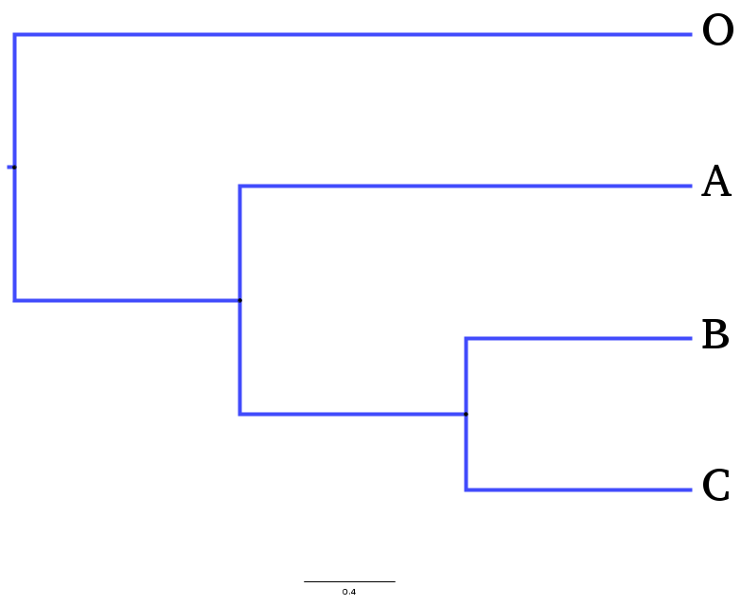
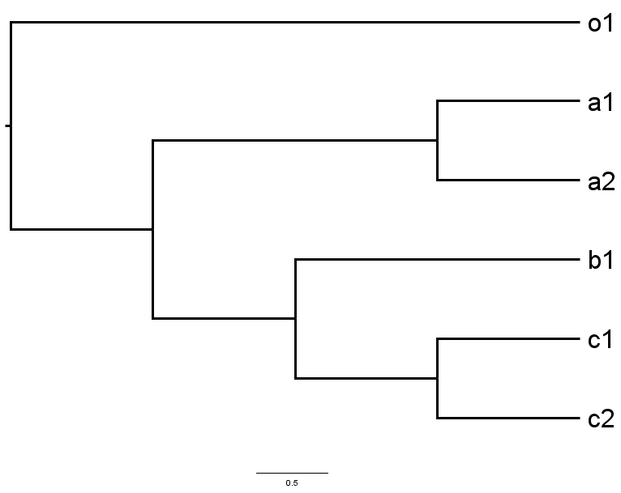
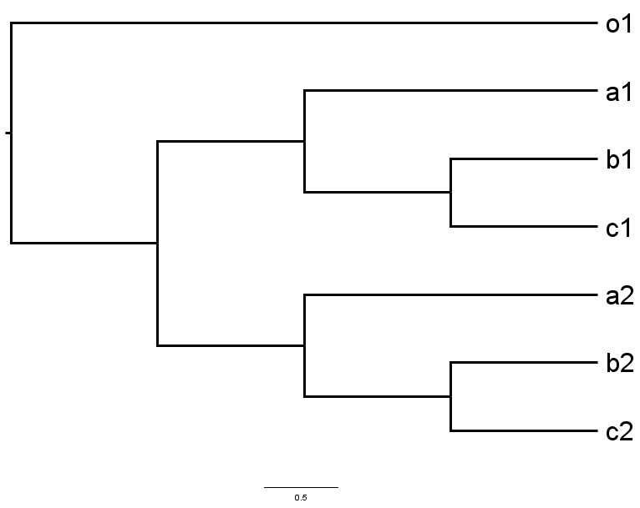
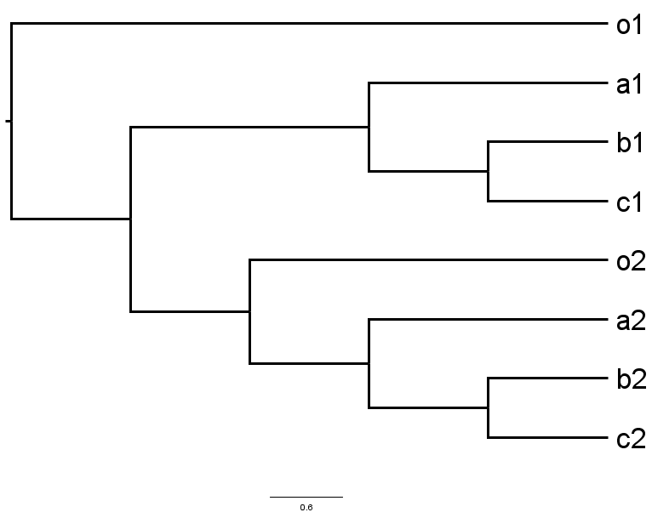
Gene family - examples
Notes:
Here are some examples for gene families with respect to outgroups
(O(A,(B,C))) - species tree
Different types of gene families with respect to outgroups.
(o1,((a1,a2),(b1,(c1,c2)))) - gene tree 1
(o1,((a1,(b1,c1)),(a2,(b2,c2))) - gene tree 2
(o1,((a1,(b1,c1)),(o2,(a2,(b2,c2))))); - gene tree 3
Gene tree 1: The is no duplication before speciation.
Gene tree 2: The is duplication before speciation and both the duplicates will be included in the gene family since it has happen divergence of the outgroup.
The gene tree with two monophyletic ingroup clades are considered as containing two separate families even though only one clade is the ideal family
Gene tree 3: This tree contains 2 monophyletic ingroup clades separated by 2 outgroup sequences. According the definition, only the most recent ingroup clade as the family, but here we consider both the clades as separate families and this also depends on the species composition of the clades.

Slide 4
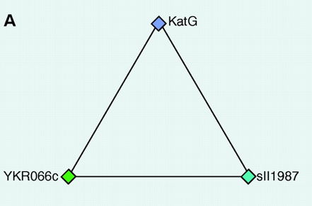
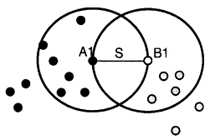
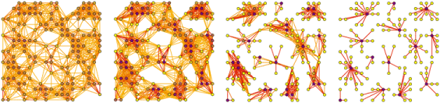
Gene family building methods
COG – reciprocal best hit triangles
Multiparanoid/Hierenoid - Inparanoid based
OrthoMCL – species normalization + Markov clustering
OrthoFinder – sequence length normalization + Markov clustering
(Tatusov et al.,1997)
(Remm et al.,2001)
(Li et al., 2003; Emms and Kelly, 2015)
Notes:
COG – triangles of rbh between 3 distinct lineages/species
Triangles with a common side are merged to form gene families
Inparanoid – works on pairs of lineages or species. A1-B1 rbh pair.
Recent paralogs in A and B are clustered together in a family
Hierenoid/Multiparanoid are works on more than 2 species through the Inparanoid approach
OrthoMCL/OrthoFinder cluster gene families using the markov clustering algorithm.
The graph of nodes as sequences and edges connecting the nodes is subjected to markov clustering algorithm

Slide 5
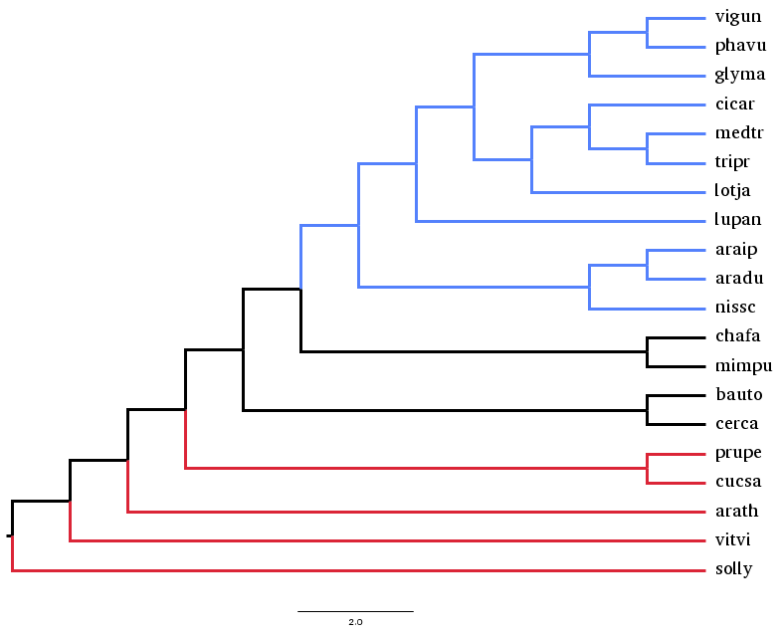
Legume evolution
Number of families
Ks-based: 17k – 18k
OrthoFinder: 20k
Reliable/good families
Sizes: 10 - 43
Vigna unguiculata
Phaselous vulgaris
Glycine max
Cicer arietinum
Medicago truncatula
Trifolium pratense
Lotus japonicus
Lupinus angustifolius
Arachis ipaensis
Arachis duranesis
Nissolia schottii
Chamaecrista fasciculata
Mimosa pudica
Bauhinia tomentosa
Cercis canadensis
Prunus persica
Cucumis sativus
Arabidopsis thaliana
Vitis vinifera
Solanum lycopersicum
(Cannon et al., 2014)
Notes:
(((((((((((vigun,phavu),glyma),((cicar,(medtr,tripr)),lotja)),lupan),((araip,aradu),nissc)),(chafa,mimpu)),(bauto,cerca)),(prupe,cucsa)),arath),vitvi),solly);
Two sets of families obtained
Expected number of legume families
In-house Ks-based families - 17k​-18k
Orthofinder – 20k families
Papilionoid WGD marked with the star.
Lineage specific WGD and WGT for Glycine and Lupin
Outgroups are marked with red.

Slide 6
Problems with gene families
Incomplete family clusters
Clusters containing more than one family
Considerable number of unclustered sequences
No approaches/methods for detecting under-clustered/over-clustered families in post-analysis
No approaches/methods for assigning reliability scores to existing families
Notes:
Generally, family building methods use common a method/parameter set to build all the families.
Different families evolve at different rates. Therefore the parameters may be suitable to some families and not for some families
Eg. Eval and mcl inflation factor cutoff
Many fragmented families could be produced
Many clusters with more than one families could be produced
According to our knowledge, currently, there are no methods that analyze gene families for these problems after they have been built.
Also, it is important to assign reliability scores to existing families to know which families can be trusted more than others.
Some families are easier the cluster than others according to their evolutionary characteristics

Slide 7
Outline
Detecting/Correcting under-clustered families
Analyzing separation of family pairs from non-family pairs
Detecting/Correcting over-clustered families
Family tree based
Protein domain composition based
Species composition based
Consensus families from multiple sets
Comparing sets of families obtained from different methods
Biological analysis of legume families
Gene Ontology analysis of families based on loss/retention of WGD duplicate

Slide 8
Detecting/Correcting under-clustered families
Hypothesis: Pairs of sequences from a family can be separated/classified from pairs of sequences between family and its non-family members, using quantitative pair features
The classification statistics can indicate family completeness
For true families, the classification statistics can be used reliability scores for families
Notes:
Explain why pairs?? And not individual sequences
More training and testing data through pairs that individual sequences. E.g. family with 10 sequences gives 10C2 = 45 pairs
Each sequence is inspected more through pairs
Modeling the bifurcating nature of gene trees by inspecting pairs of sequences as a unit rather than individual sequences

Slide 9
Pair classification method
Combined whole proteomes from all species
family fasta
phmmer database search
sequence
database
query
query
hits
Collecting closest non-family sequences for a given family
Collect all sequences (family/non-family) that match better than worst matching family sequence other than query
worst matching family
sequence other than query​
Repeat for all family sequences
Set of retrieved sequences
Notes:
This exercise intends to collects closest non-family sequences and also gives an indication of how well the given family is circumscribed
The set of retrieved sequences will contain one or more non-family sequences.
Multiple non-families sequences may be retrieved if the given family is incomplete
This a point where the pair classification method can optimized:
By reducing the initial phmmer search space
And by limiting the number of non-family sequences to reduce the training set size

Slide 10
Pair classification method (cont.)
Total retrieved sequences (N) = family sequences (n) + closest non-family sequences (N-n)
Forming family and non-family pairs
Positive pairs – sequence pairs that diverged after outgroup divergence
Negative pairs – sequence pairs that diverged before outgroup divergence
Form pairs (^{N}C₂ - ^{(N-n)}C₂))
Positive pairs
(^{n}C₂)
Negative pairs
((^{N}C₂ - ^{(N-n)}C₂)) -(^{n}C₂))
Notes:
Pairs from the retrieved sequences that belong to the original family are positive pairs I.e. these pairs of sequences are assumed to have diverged into the family after the divergence of outgroup sequences
Pairs from the retrieved sequences that are between the family sequences and non-family sequences are negative I.e. they are assumed to have diverged before or outside the family before the divergence of outgroup sequences

Slide 11
Pair classification method (cont.)
Training pair classification model for a given family
Positive pairs(^{n}C₂)
Negative pairs
((^{N}C₂ - ^{(N-n)}C₂)) -(^{n}C₂))
Random split
Training positive pairs (80%)
Test positive pairs (20%)
HMM model trained on consensus sequences of pairs
Test pairs
Repeat multiple times (10)
Align test pairs to HMM model
Save test results
Notes:
HMM model is trained on consensus sequences of the training pairs to get a model trained on pairs as a unit and not individual sequences. Hmmer tool is used to generate consensus sequences.
Individual sequences of the test pairs are aligned to the trained pair HMM model and the test results from all iterations are saved together with their actual pair labels. Two scores, for each test pair, corresponding to the two sequences of the pair are saved while testing.

Slide 12
Pair classification method (cont.)
Assessing test results for pair classification model for a given family
PAIR CLASSIFIER:
Predicted label = (+) if ((score1>=cutoff) & (score2>=cutoff)), else (-)
Classification statistics w.r.t to given cutoff
Classification performance w.r.t to given cutoff
Precision = TP/(TP+FP)
Recall = TP/(TP+FN)
F1-score = harmonic mean of Precision and Recall
Consolidated test results (from all iterations)
seq1 | seq2 | score1 | score2 | Actual label | Pred label
 |  |  |  | + | +
 |  |  |  | + | -
 |  |  |  | - | +
 |  |  |  | - | -
 |  |  |  | - | -
Pair type | Actual label | Pred label
True Positive (TP) | + | +
False Positive (FP) | - | +
True Negative (TN) | - | -
False Negative (FN) | + | -
Notes:
The consolidated test results are assessed using different cutoffs

Slide 13
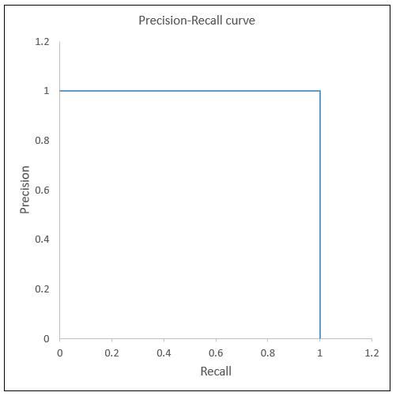
Pair classification method (cont.)
Assessing test results for pair classification model for a given family
Score cutoff???
Higher/stringent cutoffs – high Precision, low Recall
Lower/relaxed cutoffs – low Precision, high Recall
Using a range of cutoffs (high to low)
Get Precision and Recall values for different score cutoffs
Plot Precision v/s Recall (PR-curve)
Calculate area under the Precision-Recall curve (PR-AUC)
The best cutoff
Obtain the score cutoff which has best F1-score (trade-off between Precision and Recall)
Overall pair classification performance for a given family
PR-AUC (perfect = 1.0)
Score cutoff at the best F1-score

Slide 14
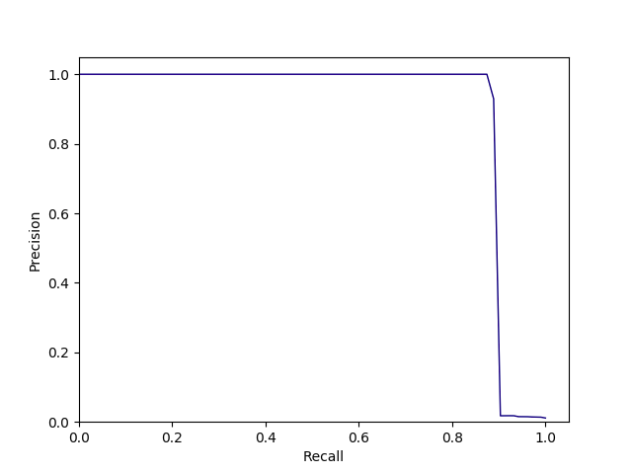
Pair classification method (cont.)
Assessing test results for pair classification model for a given family
Score cutoff???
Higher/stringent cutoffs – high Precision, low Recall
Lower/relaxed cutoffs – low Precision, high Recall
Using a range of cutoffs (high to low)
Get Precision and Recall values for different score cutoffs
Plot Precision v/s Recall (PR-curve)
Calculate area under the Precision-Recall curve (PR-AUC)
The best cutoff
Obtain the score cutoff which has best F1-score (trade-off between Precision and Recall)
Overall pair classification performance for a given family
PR-AUC (perfect = 1.0)
Score cutoff at the best F1-score
Notes:
The score cutoffs ranging for high to lowest favor high precision to high recall.
If at the best score cutoff precision is greater than recall then the cutoff will predict missing sequences with high precision and might miss some sequences that were truly missing.
If at the best score cutoff recall is high and precision is low the cutoff will predict missing sequences with high recall and may predict some wrong missing sequences.
While training the best score cutoff and the lowest score cutoff are both recorded. If the family is under-clustered and original family does not contain non-family sequences, the best cutoff is closer to the lowest cutoff, and the recall is greater that the precision at the best cutoff (as expected). This is observed in 78% of YGOB families with 20% deleted sequences.
If the user prefers high recall families and there are no non-family sequences in the family, the user can use the lowest score cutoff otherwise the best score cutoff.
Future work:
Using fbeta score instead of f1-score. The fbeta score gives cutoff that can be made to prefer recall over precision for under-clustered family.

Slide 15
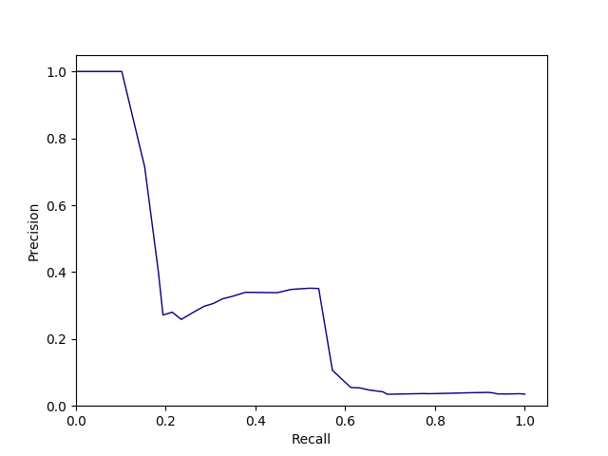
Pair classification method (cont.)
Assessing test results for pair classification model for a given family
Score cutoff???
Higher/stringent cutoffs – high Precision, low Recall
Lower/relaxed cutoffs – low Precision, high Recall
Using a range of cutoffs (high to low)
Get Precision and Recall values for different score cutoffs
Plot Precision v/s Recall (PR-curve)
Calculate area under the Precision-Recall curve (PR-AUC)
The best cutoff
Obtain the score cutoff which has best F1-score (trade-off between Precision and Recall)
Overall pair classification performance for a given family
PR-AUC (perfect = 1.0)
Score cutoff at the best F1-score

Slide 16
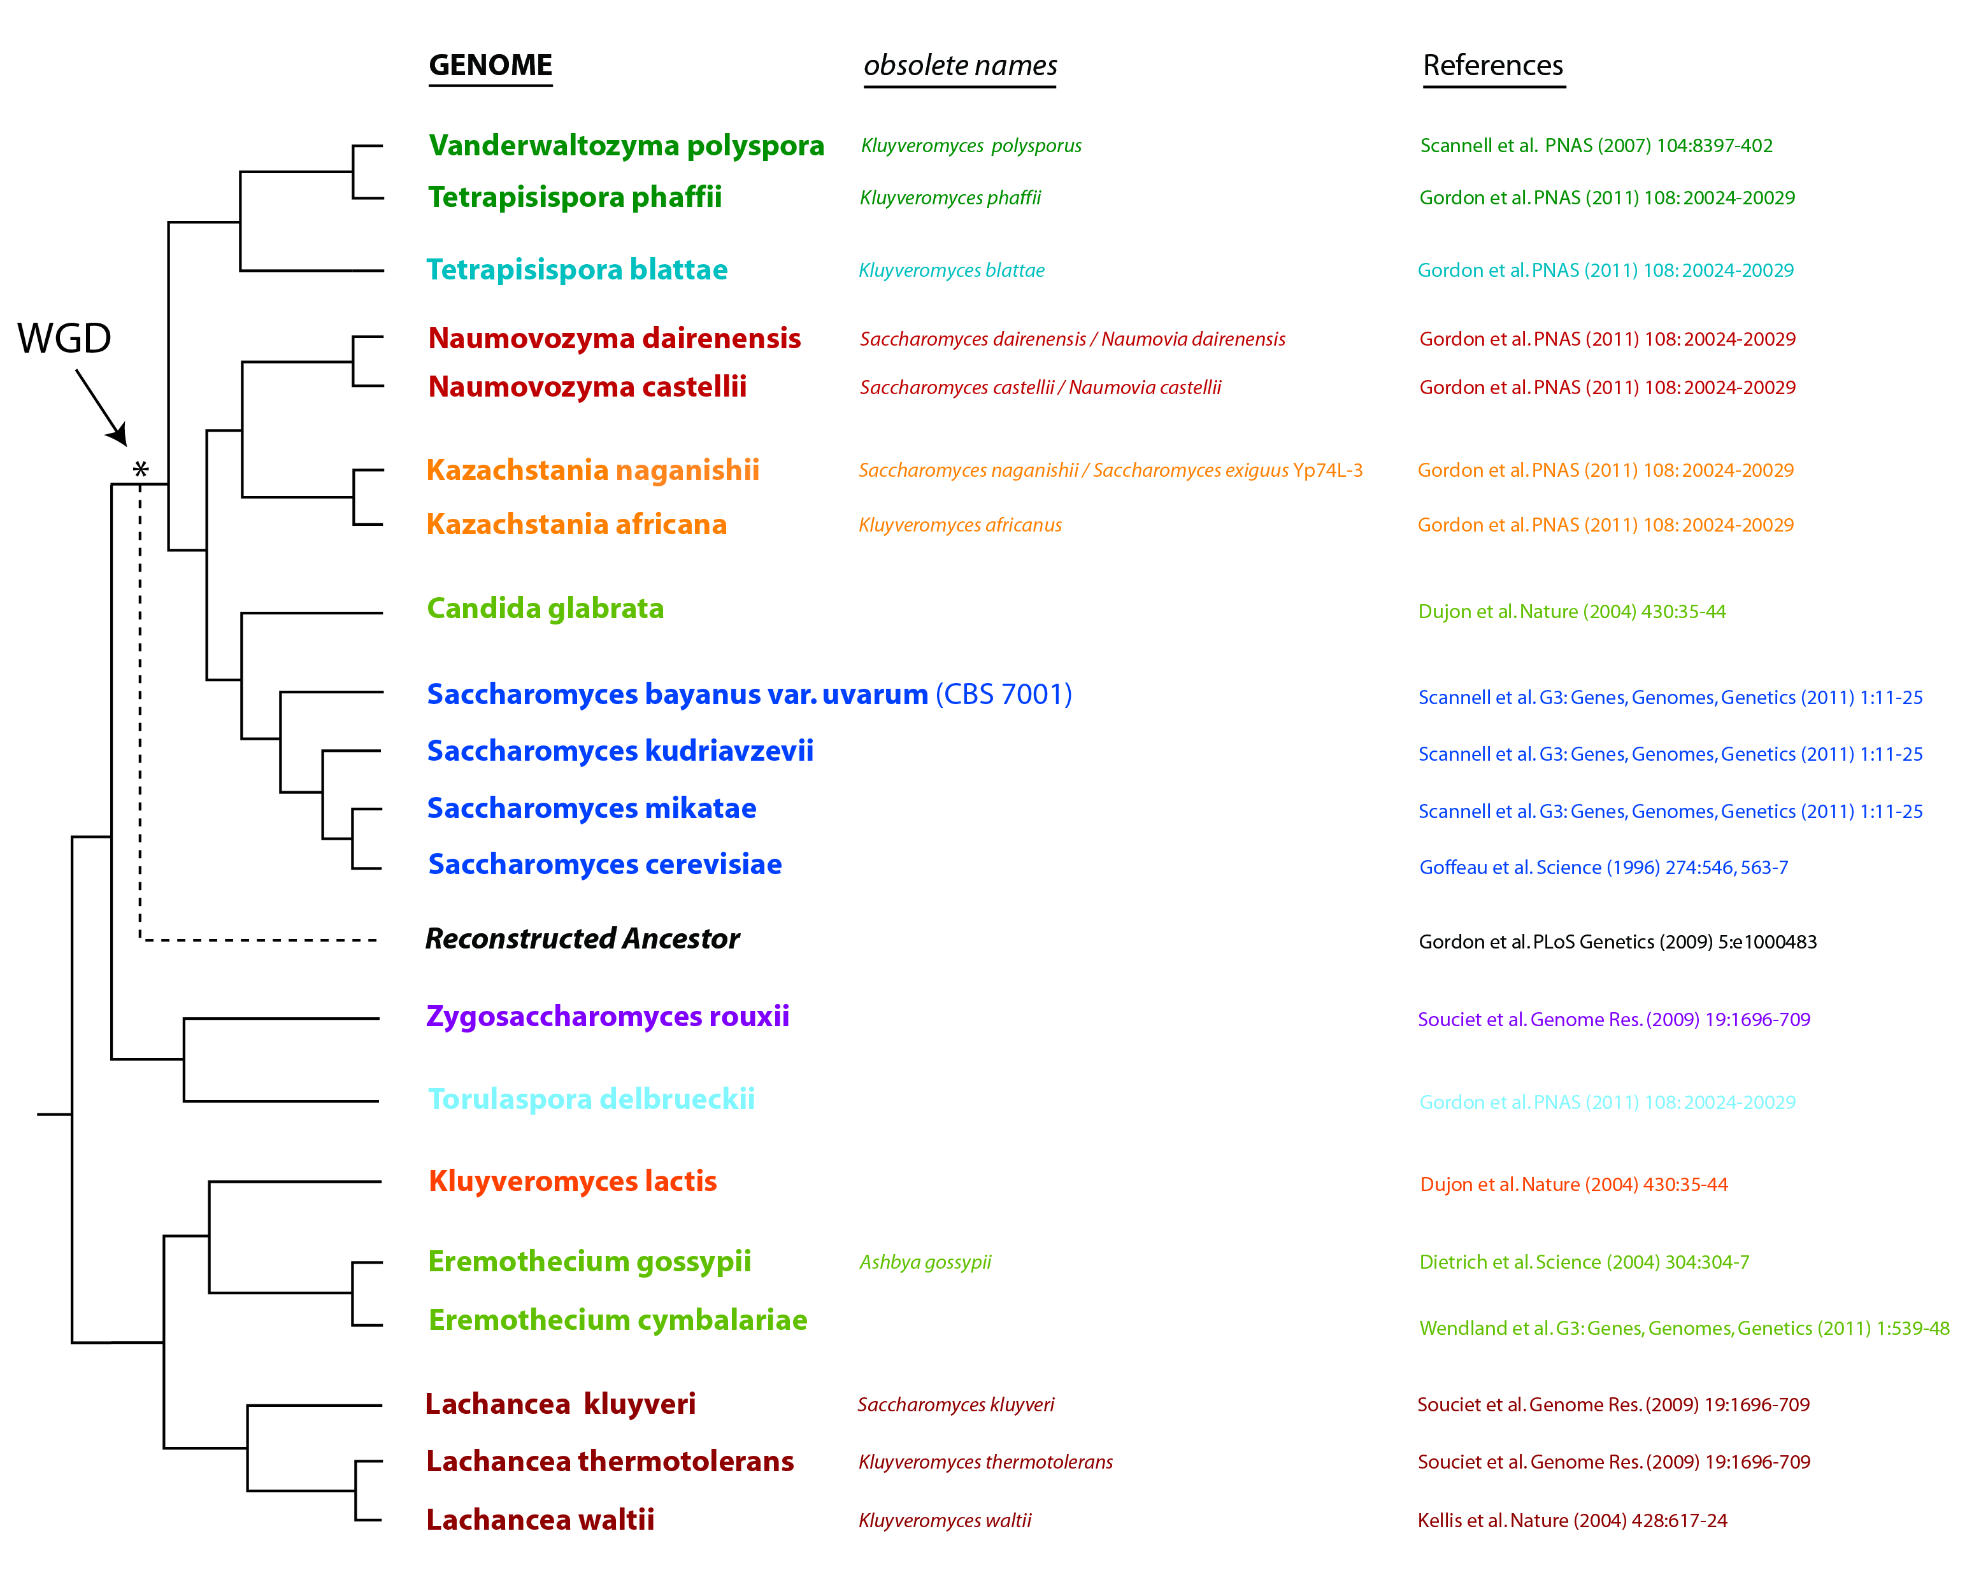
Testing the pair classification method
Behavior on “true” families
Detecting under-clustered families
Predicting missing sequences for under-clustered families
Data: Yeast Gene Order Browser (YGOB) families
20 yeast proteomes
4796 families
Manually curated based on synteny evidence
(Byrne et al.,2005)

Slide 17
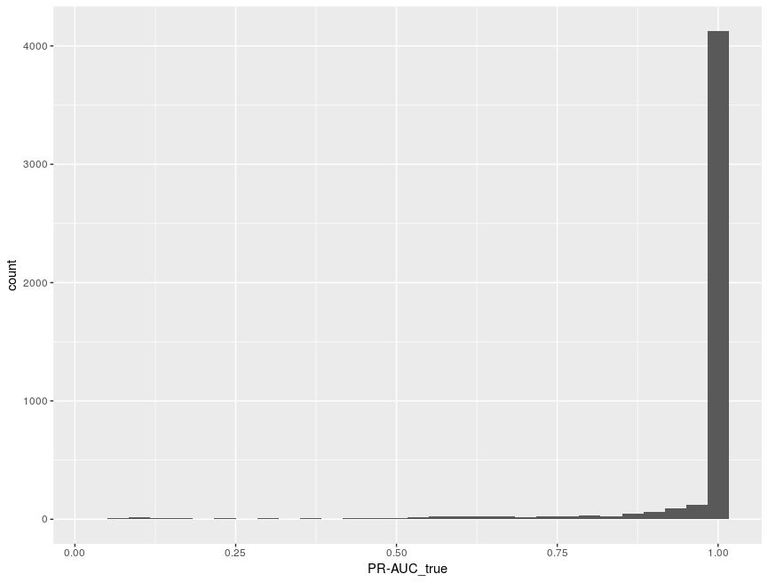
Testing pair classification method (cont.)
Behavior on “true” families
Number of families: 4796
Distribution of PR-AUC values for true families
92% of family classifiers with PR-AUC >= 0.75

Slide 18
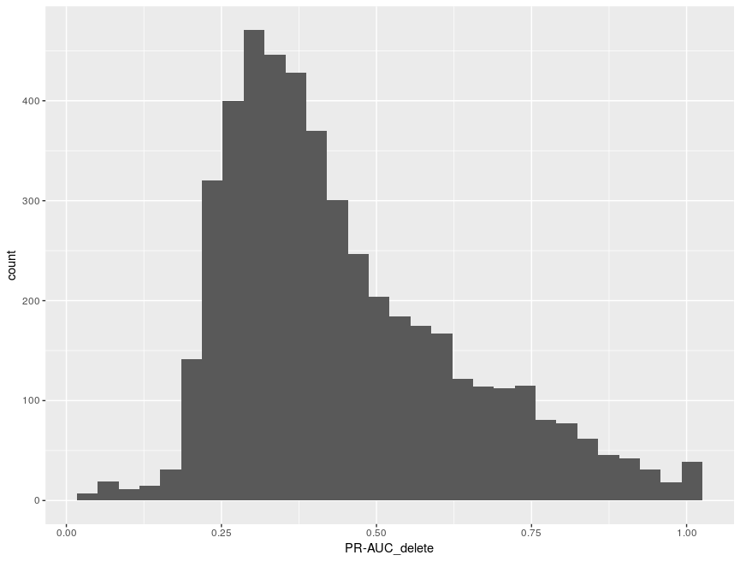
Testing pair classification method (cont.)
Detecting under-clustered families
Random 20% of sequences removed from true families
Distribution of PR-AUC values for artificially manipulated families
For 83% of families, PR-AUC dropped significantly (>= 0.9 before, < 0.75 after )

Slide 19
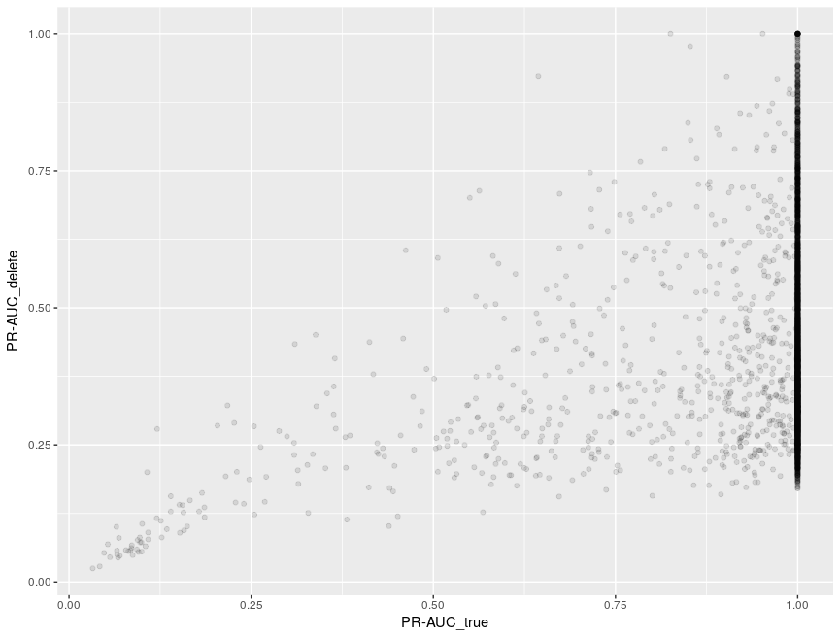
Testing pair classification method (cont.)
Detecting under-clustered families
Random 20% of sequences removed from true families
Distribution of PR-AUC values for artificially manipulated families
For 83% of families, PR-AUC dropped significantly

Slide 20
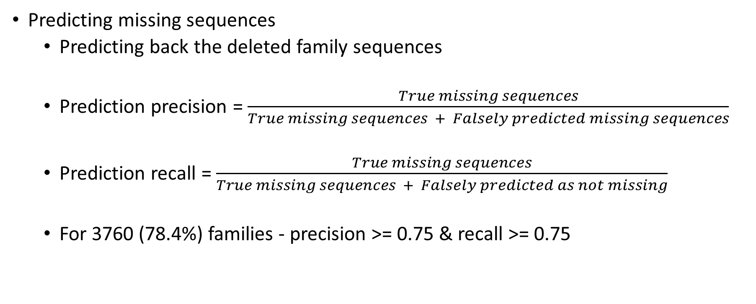
Testing pair classification method (cont.)
Predicting missing sequences
Predicting back the deleted family sequences
Prediction precision = $\frac{True missing sequences}{True missing sequences + Falsely predicted missing sequences}$
Prediction recall = $\frac{True missing sequences}{True missing sequences + Falsely predicted as not missing}$
For 3760 (78.4%) families - precision >= 0.75 & recall >= 0.75

Slide 21
Detecting/Correcting under-clustered families
Future work
Applying the method to detect/correct the Ks-based legume families
~ 2000 small families might be under-clustered
Solving scalability issues
Limiting the search space (initial phmmer search)
Limiting number of non-family sequences (reducing the number of pairs in training)

Slide 22
Detecting/Correcting over-clustered families
Tree based family scoring for detecting more than one ingroup clades, with respect to outgroups
Domain composition based family scoring for detecting unrelated sequences in family clusters
Species composition based family scoring for separating over-clustered families

Slide 23
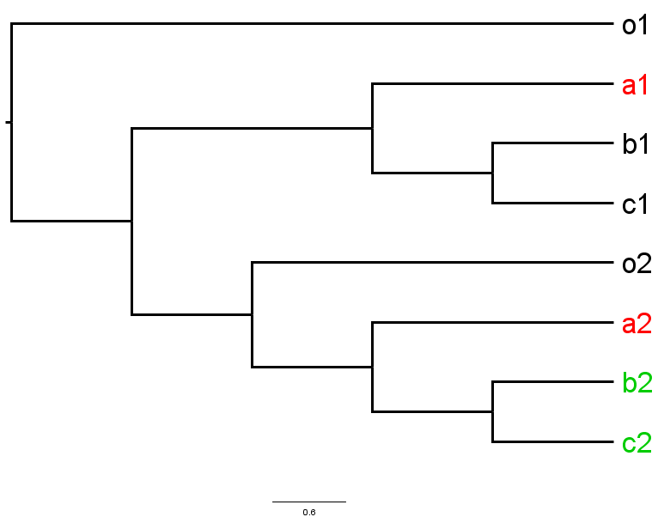
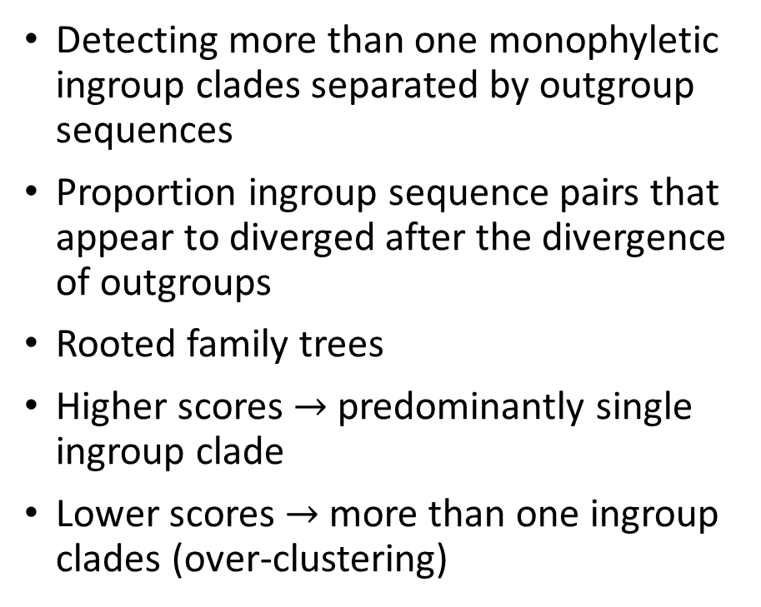
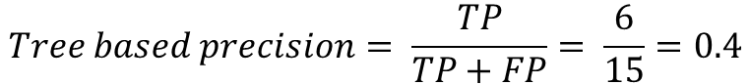
Tree based family scoring
Detecting more than one monophyletic ingroup clades separated by outgroup sequences
Proportion ingroup sequence pairs that appear to diverged after the divergence of outgroups
Rooted family trees
Higher scores $→$ predominantly single ingroup clade
Lower scores $→$ more than one ingroup clades (over-clustering)
$$Tree based precision= \frac{TP}{TP+FP}= \frac{6}{15}=0.4$$
Notes:
(o1,((a1,(b1,c1)),(o2,(a2,(b2,c2)))));
Why pair based approach and not a simple clade based approach??
Want to use the divergence property with respect to the outgroups. Use the bifurcation nature of the trees
Every ingroup sequence is inspected with respect to every other ingroup sequence in the family.
The clade based approach requires extra decisions and extra information for selecting the legitimate clade, when more than one clades are detected.

Slide 24
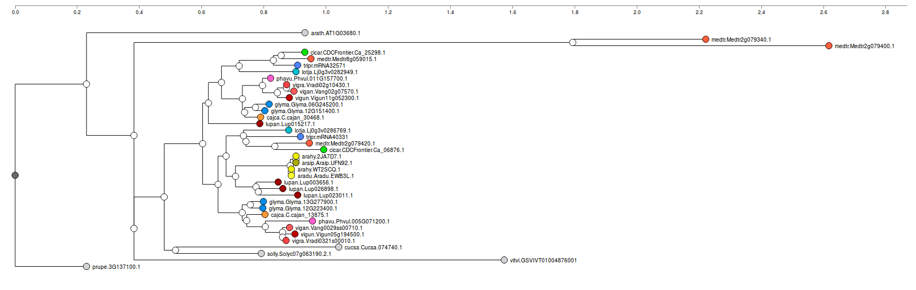
Tree based family scoring
L_4VWLVV = 0.879
Notes:
For this family, we will need to eliminate the small two sequence clade and consider the larger clade as the legitimate clade to score the family using the clade based approach. We will need some extra information make the decision on which clade to select although this can be easily done using the clade size, in this case.

Slide 25
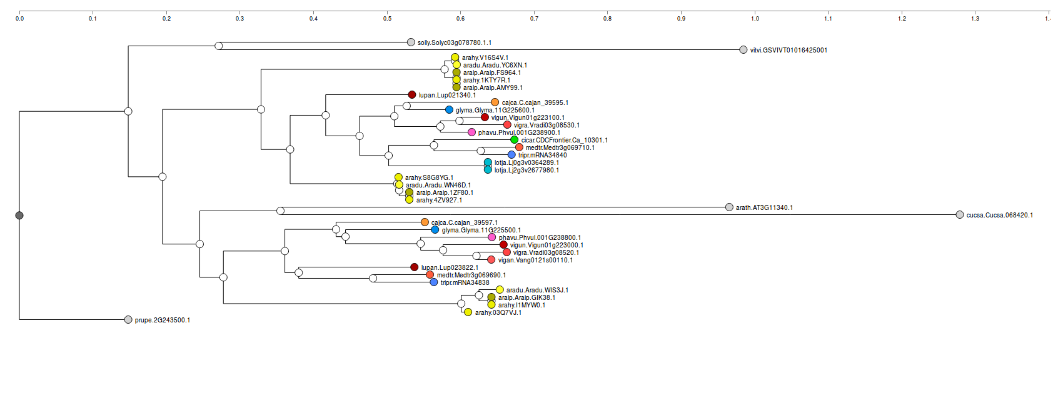
Tree based family scoring (cont.)
L_4L11VC = 0.507
Notes:
Here we will have to use some extra information to decide which ingroup clade to use for the clade based approach. The recent diverging clade has less number of sequences and also represented by less species. The larger clade is diverging earliest but seems to represented by more number of species. The choice ingroup clade will determine the overall family score.
We don't have these problems for the pair based approach.
20 sequences in 1st clade
14 sequences in 2nd clade
20/34 = 0.58
14/34 = 0.41

Slide 26
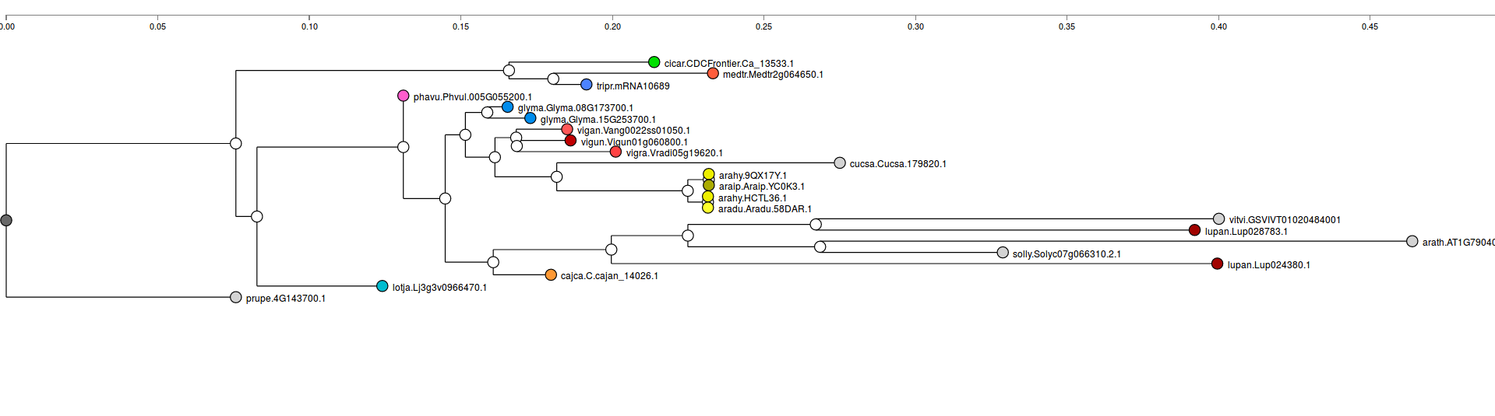
Tree based family scoring (cont.)
L_J5W12Z = 0.095
Notes:
It will be difficult to obtain a score using the clade detection based approach. Since is no legitimate monophyletic ingroup clade in this tree we cannot get proportion of ingroup sequences that form a monophyletic clade in the given family tree. The pair based approach is able to assign a low score to the tree

Slide 27
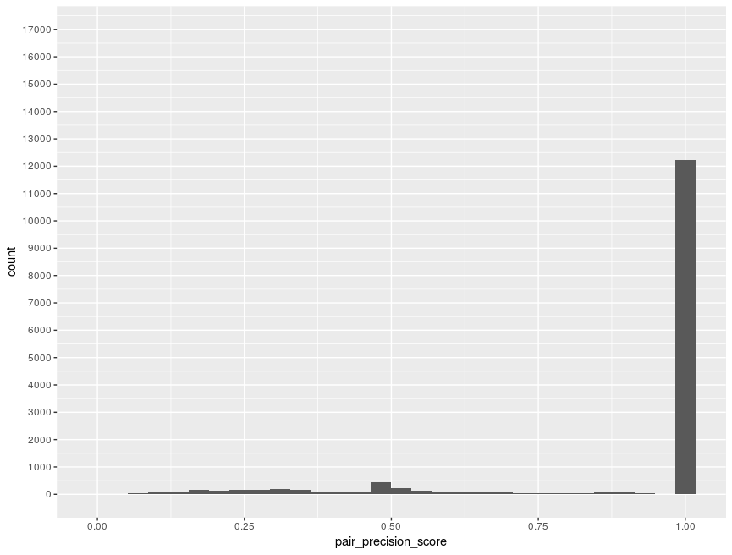
Tree based family scoring (cont.)
Distribution of tree based pair precision scores for Ks-based legume families
Majority of family trees have predominantly one ingroup clade
Peak around 0.4 - 0.5 indicates roughly two ingroup clades separated by outgroup sequences
Overall quality of families seen from the plot
Notes:
((o1,((a1,(b1,c1)))),(a2,(b2,c2)),o2)

Slide 28
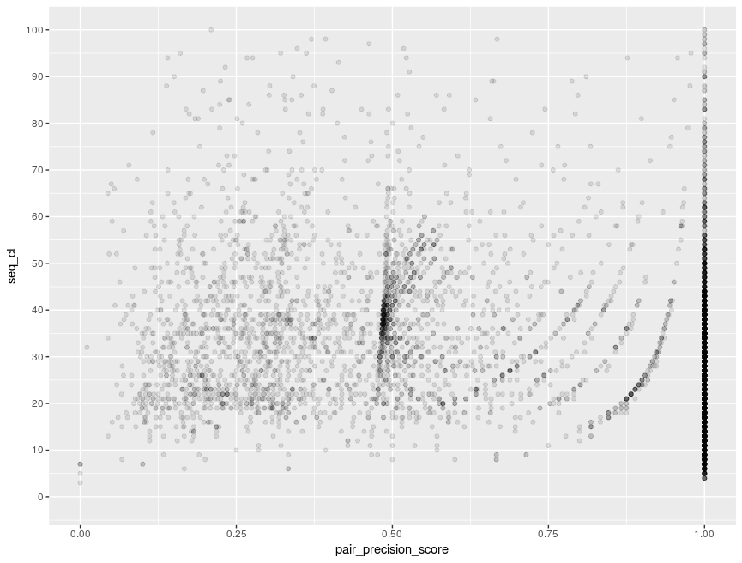
Tree based family scoring (cont.)
Relationship between family size and tree based pair precision score
Families containing 35 – 45 ingroup sequences (score ~ 0.5) could be over-clustered
Notes:
((o1,((a1,(b1,c1)))),(a2,(b2,c2)),o2)

Slide 29
Protein domains
Independent sections of protein sequences that can fold and function independently
Single domain and multidomain proteins
Protein sequences can also evolve through domain insertion/deletion/duplication
Closely related sequences within the same family can be expected to have similar domain compositions

Slide 30
Domain composition based family scoring
family
sequence pair
pfam
pfam
seq1(E.g. A-B-B-C)
seq2 (E.g. A-A-B-D)
seq1: domain alignment scores vector
seq2: domain alignment scores vector
family score = avg domain composition cosine score
seq1-seq2: domain composition cosine score

Slide 31
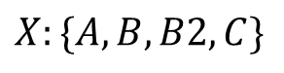
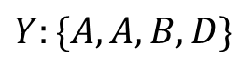
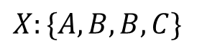
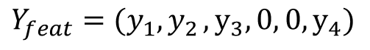
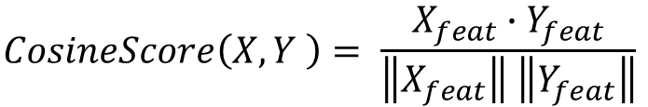
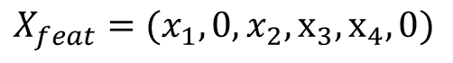
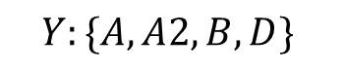
Domain composition based family scoring (cont.)
Domain composition based Cosine score
$$X:\{A,B,B,C\}$$
$$Y:\{A,A,B,D\}$$
$$X:\{A,B,B2,C\}$$
$$Y:\{A,A2,B,D\}$$
$$Domain Universe Set (X,Y): \{A, A2, B, B2, C, D\}$$
$$X_{feat}=(x_{1},0, x_{2}, x_{3},x_{4},0)$$
$$Y_{feat}=(y_{1}{,y}_{2}, y_{3},0, 0,y_{4})$$
$$CosineScore\left(X,Y \right)= \frac{X_{feat}∙Y_{feat}}{\left\|X_{feat}\right\| \left\|Y_{feat}\right\|}$$
Notes:
Talk about pfam domain clans

Slide 32
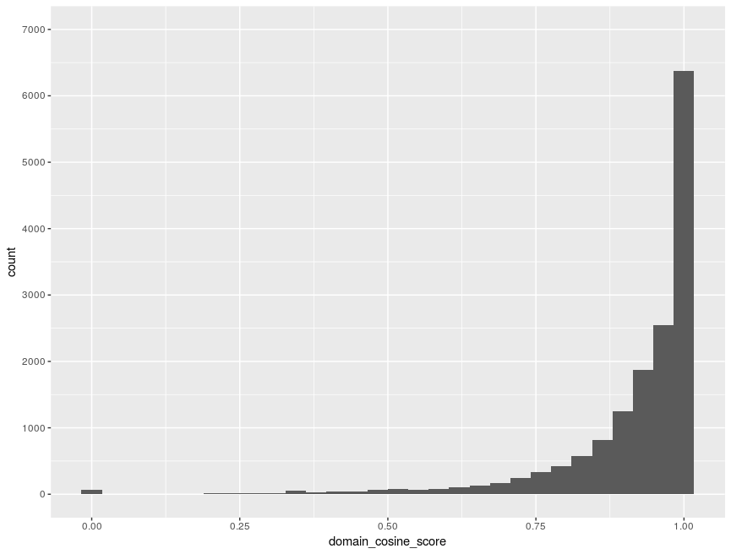
Domain composition based family scoring (cont.)
Distribution of domain composition based family scores for Ks-based legume families
Majority of families have high domain composition scores
Domain composition based characteristics of the families

Slide 33
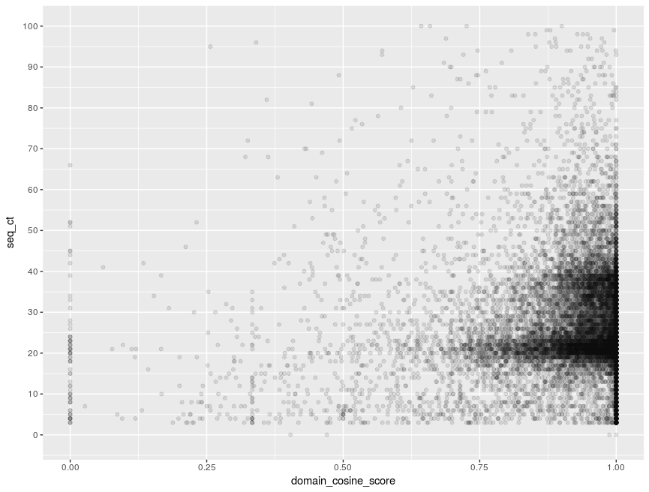
Domain composition based family scoring (cont.)
Relationship between domain composition based family scores and family size
Families with sizes between 15 - 45 have high domain composition scores

Slide 34
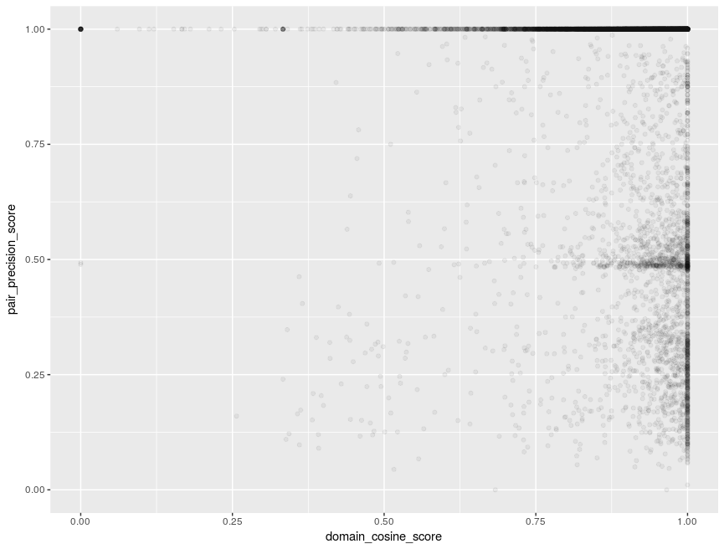
Domain composition based family scoring (cont.)
Relationship between domain composition based scores and tree based precision scores
Majority of families in upper right corner
Over-clustered families have high domain composition scores
Families in lower right – problems with trees/tree rooting?

Slide 35
Species compostion based family scoring
Good/consistent families can be expected to be represented evenly by majority of species under study
Scoring families by comparing expected species counts to observed species counts
Expected species counts are obtained based on WGD histories of the species and assuming no gene loss (legume families)
The expected species count vector is compared to the observed species count vector using the Cosine function.

Slide 36
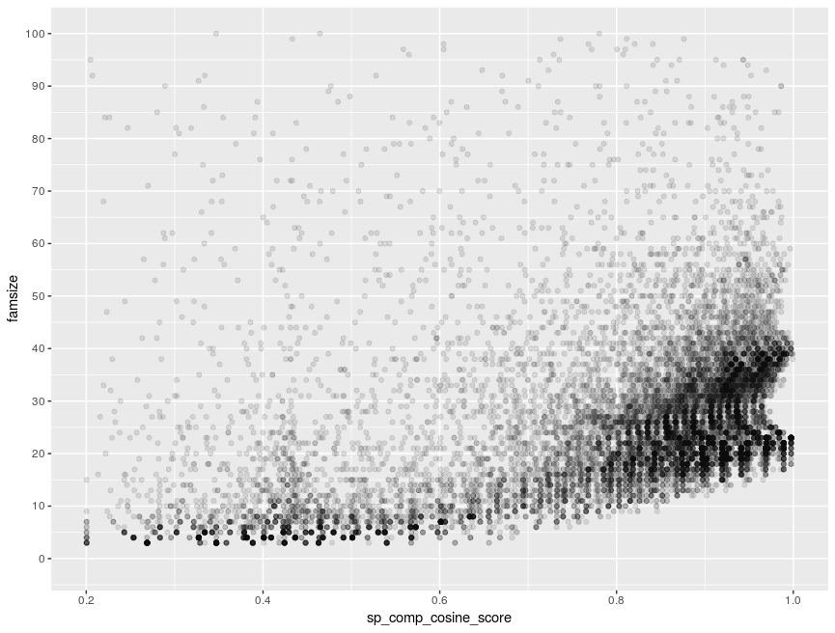
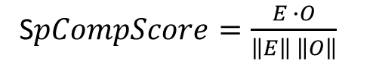
Species composition based family scoring (cont.)
Relationship between family size and species composition score for Ks-based legume families
Species ID | Expected gene counts
glyma | 4
phavu | 2
vigan | 2
vigra | 2
vigun | 2
cajca | 2
medtr | 2
cicar | 2
tripr | 2
lotja | 2
lupan | 6
aradu | 2
araip | 2
arahy | 4
S$pCompScore=\frac{E ∙O}{\left\|E\right\| \left\|O\right\|}$

Slide 37
Detecting/Correcting over-clustered families
Future work
Separating over-clustered families detected using tree based and domain composition based family scores
Species composition based scoring can be used to detect legitimate family clades while separating
Investigating corrected families from the pair classification method for over-clustering
Developing the scoring methods into Python tools

Slide 38
Consensus families from multiple sets
Consistent, well-behaved families can be expected to be detected by multiple family building methods
Comparing family sets
Family correspondence and two-way overlap
A_2
B_1
B_2
A_1
A_3
B_3
B_4

Slide 39
Consensus families from multiple sets (cont.)
hmmscan
HMM set 1
Family set1
Classify each sequence into best matching HMM family
Corresponding families with two-way overlaps
sequence set
HMM set 2
Family set2
hmmscan

Slide 40
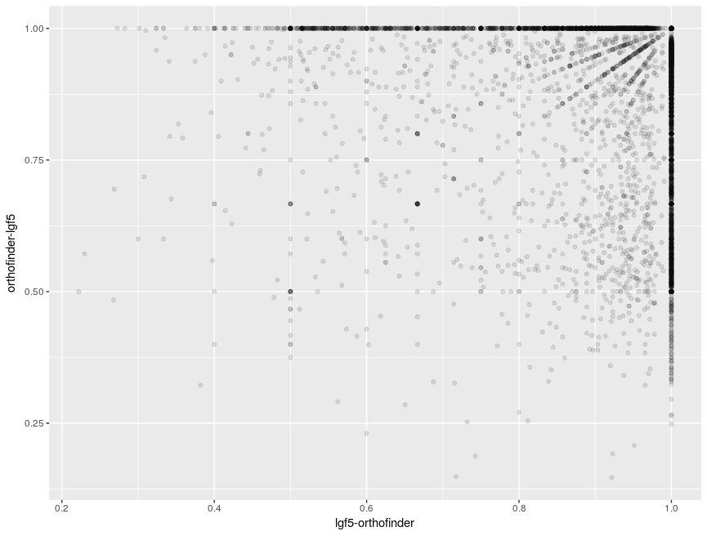
Consensus families from multiple sets (cont.)
Comparing Ks-based and OrthoFinder legume families
9160 families match exactly between both the sets
11550 families match with 0.9 overlap scores (both ways)
Distribution of ingroup sequence counts for the Ks-based families with both overlaps scores ≥ 0.9
Notes:
Bottom right – lgf5 family inside orthofinder family
Top left – orthofinder family inside lgf5 family

Slide 41
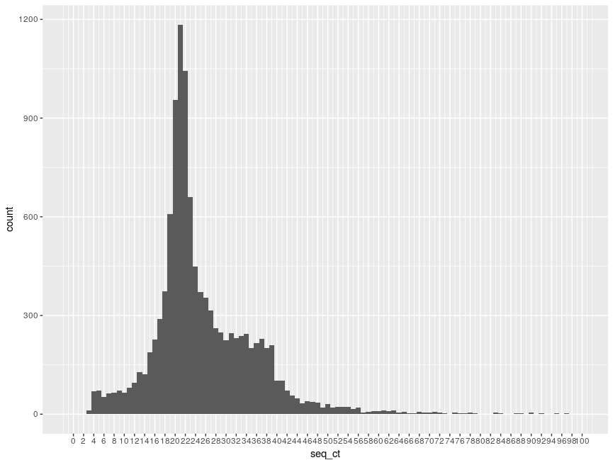
Consensus families from multiple sets (cont.)
Comparing Ks-based and OrthoFinder legume families
9160 families match exactly between both the sets
11550 families match with 0.9 overlap scores (both ways)
Distribution of family sizes for the Ks-based families with both overlaps scores ≥ 0.9

Slide 42
Consensus families from multiple sets (cont.)
Future work
Repeating the analysis on corrected families (under/over-clustering)
Developing the workflow into Python tool that can be used on any two sets of families
The consensus families can be released as high-confidence set of legume families

Slide 43
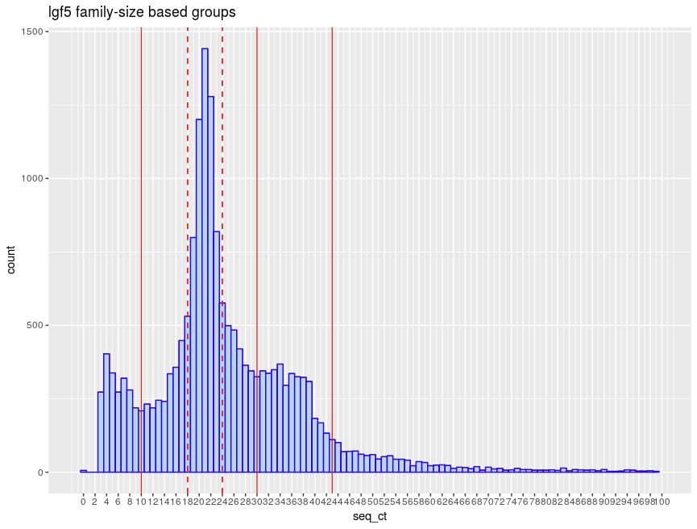
Biological analysis of legume families
Legume families can be divided into different size classes
Retention/Loss of duplication from WGD
Gene specific loss/muplication
Is there any biological basis to this phenomena?
Gene Ontology analysis of genes (soybean) in different size groups

Slide 44
Biological analysis of legume families (cont.)
GO ID | p-value | GO description
GO:0009816 | 10 ⁻⁹ | defense response to bacterium, incompatible interaction
GO:0010026 | 10⁻⁵ | trichome differentiation
GO:0006355 | 10 ⁻⁴ | regulation of transcription, DNA-dependent
GO:0015690 | 10 ⁻³ | aluminum cation transport
GO:0009612 | 10 ⁻² | response to mechanical stimulus
GO ID | p-value | GO description
GO:0006952 | 10 ⁻¹⁹¹ | defense response
GO:0007165 | 10 ⁻⁶⁶ | signal transduction
GO:0006412 | 10 ⁻⁵⁴ | translation
GO:0055114 | 10 ⁻⁴¹ | oxidation-reduction process
GO:0006865 | 10 ⁻⁴¹ | amino acid transport
Group 1 GO enrichment (size < 10)
Group 4 GO enrichment (size > 43)
Number of enriched categories = 7
Number of enriched categories = 268

Slide 45
Biological analysis of legume families (cont.)
GO ID | p-value | GO description
GO:0009658 | 10 ⁻⁴⁵ | chloroplast organization
GO:0010027 | 10 ⁻⁴⁵ | thylakoid membrane organization
GO:0019288 | 10 ⁻⁴⁰ | isopentenyl diphosphate biosynthetic process
GO:0006364 | 10 ⁻³⁷ | rRNA processing
GO:0019252 | 10 ⁻³⁵ | starch biosynthetic process
GO ID | p-value | GO description
GO:0006355 | 10 ⁻⁹² | regulation of transcription, DNA-dependent
GO:0006468 | 10 ⁻²⁵ | protein phosphorylation
GO:0010200 | 10 ⁻²¹ | response to chitin
GO:0010075 | 10 ⁻²⁰ | regulation of meristem growth
GO:0009651 | 10 ⁻¹⁹ | response to salt stress
Group 2 GO enrichment (10 < size < 30)
Group 3 GO enrichment (30 < size < 43)
Number of enriched categories = 176
Number of enriched categories = 216

Slide 46
Biological analysis of legume families (cont.)
Future work
GO analysis on the corrected families
GO analysis of fast/slow-evolving families detected on high-confidence families using domain composition based methods

Slide 47
Thank you

